Slide 1


Nutan Maharashtra Vidya Prasarak Mandal’s NUTAN COLLEGE OF ENGINEERING AND RESEARCH Under Administrative Support of Pimpri Chinchwad Education Trust ISO 21001:2018 EOMS Certified
Seminar / Project Review / Project Presentation
Presentation on:
Solar Panel Crack Detection Using Image Processing
By
Arpita Phalke(43)
Kirti Rachkar(47)
Shruti Jadhav(38)
Department of Computer Science Engg - Aritificial Intelligence

Slide 2
Nutan Maharashtra Vidya Prasarak Mandal’s NUTAN COLLEGE OF ENGINEERING AND RESEARCH Under Administrative Support of Pimpri Chinchwad Education Trust ISO 21001:2018 EOMS Certified
Seminar / Project Review / Project Presentation
Introduction:
Solar energy serves as a pivotal renewable energy source, contributing significantly to sustainable power generation.
The efficacy and endurance of solar panels are crucial in ensuring optimal energy production. However, the presence of cracks and damages on solar panels can substantially hinder their efficiency.
Timely identification and remediation of these defects are imperative to maintain peak performance and extend the lifespan of solar panel installations.

Slide 3
Nutan Maharashtra Vidya Prasarak Mandal’s NUTAN COLLEGE OF ENGINEERING AND RESEARCH Under Administrative Support of Pimpri Chinchwad Education Trust ISO 21001:2018 EOMS Certified
Seminar / Project Review / Project Presentation
Problem statement:
Creating an automated system that learns to detect cracks in solar panels from images. This involves training a computer program using a dataset that includes images of both undamaged and damaged panels.
The ultimate goal is to develop a dependable tool that, after learning from these images, can accurately identify and flag damaged solar panels.

Slide 4
Nutan Maharashtra Vidya Prasarak Mandal’s NUTAN COLLEGE OF ENGINEERING AND RESEARCH Under Administrative Support of Pimpri Chinchwad Education Trust ISO 21001:2018 EOMS Certified
Seminar / Project Review / Project Presentation
OBJECTIVE:
1.Algorithm Development: Design and implement machine learning models, such as Convolutional Neural Networks (CNNs) or transfer learning with architectures like VGG16, to accurately detect and localize cracks within solar panel images.
2. Model Training: Train the developed algorithms using the collected dataset to learn distinctive features associated with both clean surfaces and different types of damages, ensuring robust crack detection capabilities.
3.Detection of Cracks: Develop a system that can accurately detect the presence of cracks on solar panels in input images.
4.Accuracy: Achieve a high level of accuracy in crack detection to minimize false positives and false negatives, ensuring reliable performance.

Slide 5
Nutan Maharashtra Vidya Prasarak Mandal’s NUTAN COLLEGE OF ENGINEERING AND RESEARCH Under Administrative Support of Pimpri Chinchwad Education Trust ISO 21001:2018 EOMS Certified
Seminar / Project Review / Project Presentation
Existing System:
The existing systems for solar panel crack detection using images often involve manual inspection and maintenance processes. These systems rely on human operators to visually inspect solar panels for cracks and other defects.
Proposed System:
The idea for finding cracks in solar panels using pictures involves using computers and smart technology. Here are some key aspects of the proposed system:
Image Preprocessing: Preprocessing techniques are applied to enhance the quality of the given dataset images.
Crack Detection: Machine learning models, such as Convolutional Neural Networks (CNNs), are trained to detect cracks within the solar panel images. These models can identify the presence of cracks
Model Training using CNN & VGG16:
This phase involves training a Convolutional Neural Network (CNN) using the segregated dataset of clean and damaged images. The CNN model learns features and patterns from the images to differentiate between clean and damaged panels.

Slide 6
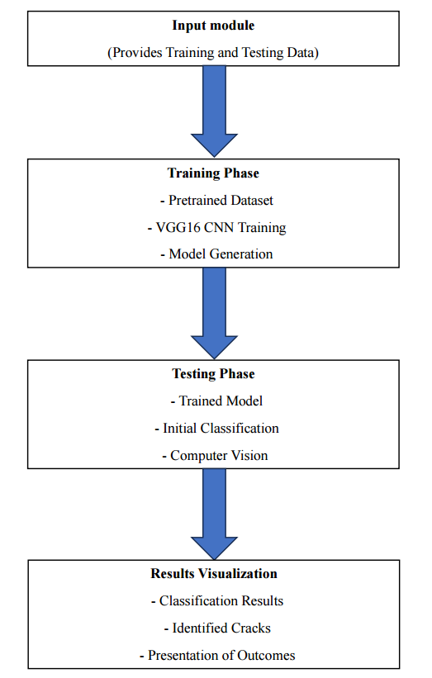
Nutan Maharashtra Vidya Prasarak Mandal’s NUTAN COLLEGE OF ENGINEERING AND RESEARCH Under Administrative Support of Pimpri Chinchwad Education Trust ISO 21001:2018 EOMS Certified
Seminar / Project Review / Project Presentation
METHODOLOGY:
Gathered diverse solar panel images Split dataset (training/validation)Standardized image sizes model
Selection & Customization
Chose VGG16 for transfer learning Removed
classification layers Added layers for crack detection
Training & Validation
3. Trained model on training data Validated on separate
dataset Evaluation & Inspection
4. Plan for model deployment Iterative improvements
for enhanced accuracy

Slide 7
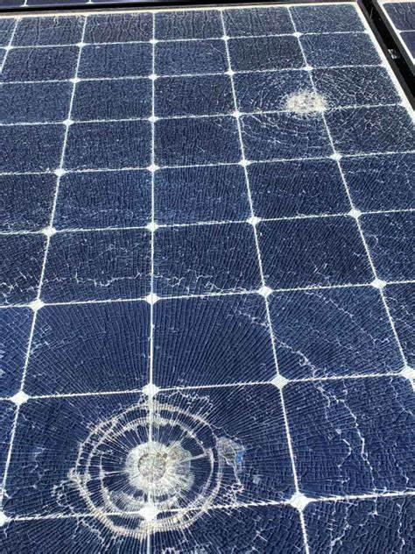

Nutan Maharashtra Vidya Prasarak Mandal’s NUTAN COLLEGE OF ENGINEERING AND RESEARCH Under Administrative Support of Pimpri Chinchwad Education Trust ISO 21001:2018 EOMS Certified
Seminar / Project Review / Project Presentation

Slide 8
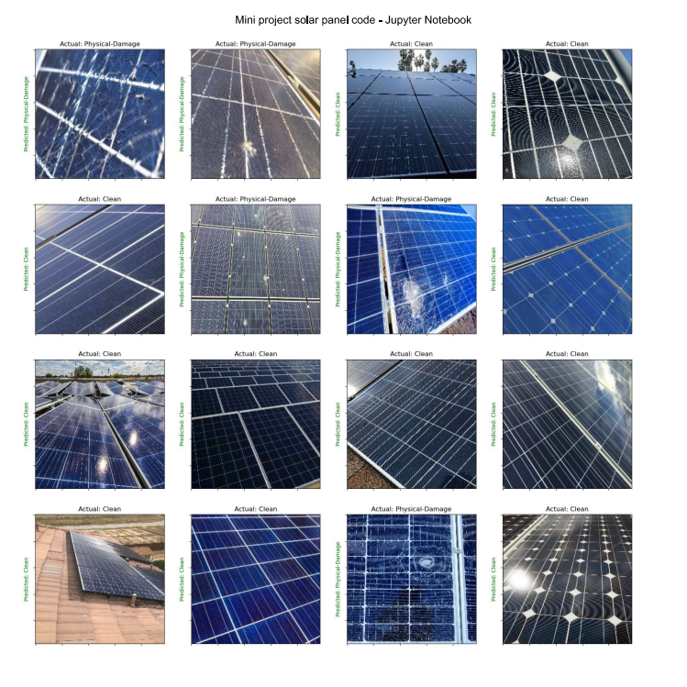
Nutan Maharashtra Vidya Prasarak Mandal’s NUTAN COLLEGE OF ENGINEERING AND RESEARCH Under Administrative Support of Pimpri Chinchwad Education Trust ISO 21001:2018 EOMS Certified
Seminar / Project Review / Project Presentation

Slide 9
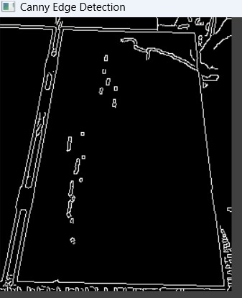
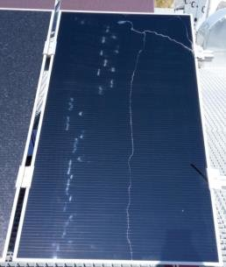
Nutan Maharashtra Vidya Prasarak Mandal’s NUTAN COLLEGE OF ENGINEERING AND RESEARCH Under Administrative Support of Pimpri Chinchwad Education Trust ISO 21001:2018 EOMS Certified
Seminar / Project Review / Project Presentation

Slide 10
Nutan Maharashtra Vidya Prasarak Mandal’s NUTAN COLLEGE OF ENGINEERING AND RESEARCH Under Administrative Support of Pimpri Chinchwad Education Trust ISO 21001:2018 EOMS Certified
Seminar / Project Review / Project Presentation
CONCLUSION
The implementation of a solar panel crack detection system utilizing Convolutional Neural Networks (CNN) and VGG16 has showcased promising results in automating the identification and localization of cracks in solar panels.
The CNN model demonstrated commendable performance in accurately identifying crack areas within solar panel images, leveraging its ability to learn intricate patterns and features. On the other hand, the VGG16 model, utilizing transfer learning from pre-trained weights, showcased robustness in crack classification tasks, contributing significantly to the overall detection process.

Slide 11
Nutan Maharashtra Vidya Prasarak Mandal’s NUTAN COLLEGE OF ENGINEERING AND RESEARCH Under Administrative Support of Pimpri Chinchwad Education Trust ISO 21001:2018 EOMS Certified
Seminar / Project Review / Project Presentation
REFERENCES:
[1] Andi Najiah Nurul Afifah, Indrabayu , Ansar Suyuti and Syafaruddin : A review on image processing techniques for damage detection on photovoltaic panels.
[2] Xiaoliang Qian , Heqing Zhang , Huanlong Zhang , Yuanyuan Wu, Zhihua Diao : Solar Cell Surface Defects Detection based on Computer Vision.
[3] Arun Mohan and Sumathi Poobal : Crack detection using image processing: A critical review and analysis.
[4] Dhimish, Mahmoud and Mather, Peter : Ultra-Fast High-Resolution Solar Cell Cracks Detection Process.
[5] Huaiguang Liu, Wancheng Ding , Qianwen Huang , and Li Fang : Research on Online Defect Detection Method of Solar Cell Component Based on Lightweight Convolutional Neural Network.
[6] Mahmoud Dhimish And Violeta Holmes : Solar cells micro crack detection technique using state-of-the-art electroluminescence imaging.

